Slide 1
NETRA GUIDE
REVIEW-1
TEAM MEMBERS
PROJECT COORDINATOR 23L31A4351
Mrs M.Arunakumari 23L31A4352
23L31A4353
23L31A4354
23L31A4355
23L31A4356

Slide 2

PROJECT GENESIS:THE BEGINNING
Many students struggle to find the right tutor who matches their learning style and needs.
Netra Guide serves as a bridge between students and qualified tutors, making education accessible.
An intuitive platform where students can search, compare, and connect with tutors effortlessly.
Ensuring quality education through a network of skilled and experienced teachers.
Learn at your own pace, anytime, anywhere, with a tutor who fits your schedule.

Slide 3

How It Works: A Simple Three-Step Process
Search 🔍
Students browse through a wide range of verified tutors.
Filters available based on subject, experience, location, and fees.
Recommendations suggest the best match for each student.
Connect 🤝
Connect through contact numbers given by the tutors.
Learn 📚
Personalized learning sessions based on student needs
Flexible scheduling for both students and teachers.

Slide 4
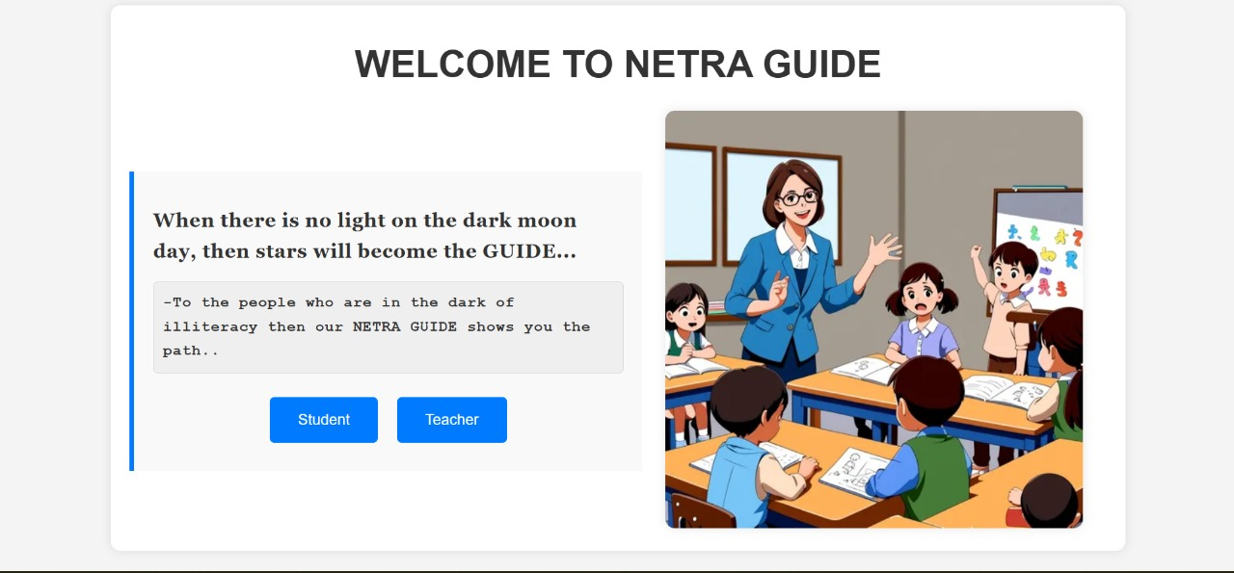
Bringing innovation to life: an introduction

Slide 5
Building the Netra Guide Home Page: A Seamless User Experience
🛠 Technologies Used:
✅ HTML – Structuring the page for a clean and intuitive layout.
✅ CSS – Styling for a visually appealing and responsive design.
🎯 Key Features:
📌 User-Friendly Interface – Simple navigation for students and tutors.
📌 Quick Search & Filters – Easily find the right tutor.
📌 Interactive Dashboard – Personalized experience for students and teachers.

Slide 6
THANK YOU

